Slide 1
Chapter 2 Elementary Programming

Slide 2
NOTE
Calculations involving floating-point numbers are approximated because these numbers are not stored with complete accuracy. For example,
System.out.println(1.0 - 0.1 - 0.1 - 0.1 - 0.1 - 0.1);
displays 0.5000000000000001, not 0.5, and
System.out.println(1.0 - 0.9);
displays 0.09999999999999998, not 0.1. Integers are stored precisely. Therefore, calculations with integers yield a precise integer result.

Slide 3
Exponent Operations
System.out.println(Math.pow(2, 3));
// Displays 8.0
System.out.println(Math.pow(4, 0.5));
// Displays 2.0
System.out.println(Math.pow(2.5, 2));
// Displays 6.25
System.out.println(Math.pow(2.5, -2));
// Displays 0.16

Slide 4
Number Literals
A literal is a constant value that appears directly in the program. For example, 34, 1,000,000, and 5.0 are literals in the following statements:
int i = 34;
long x = 1000000;
double d = 5.0;

Slide 5
Integer Literals
An integer literal can be assigned to an integer variable as long as it can fit into the variable. A compilation error would occur if the literal were too large for the variable to hold. For example, the statement byte b = 1000 would cause a compilation error, because 1000 cannot be stored in a variable of the byte type.
An integer literal is assumed to be of the int type, whose value is between -2³¹ (-2147483648) to 2³¹–1 (2147483647). To denote an integer literal of the long type, append it with the letter L or l. L is preferred because l (lowercase L) can easily be confused with 1 (the digit one).

Slide 6
Floating-Point Literals
Floating-point literals are written with a decimal point. By default, a floating-point literal is treated as a double type value. For example, 5.0 is considered a double value, not a float value. You can make a number a float by appending the letter f or F, and make a number a double by appending the letter d or D. For example, you can use 100.2f or 100.2F for a float number, and 100.2d or 100.2D for a double number.

Slide 7
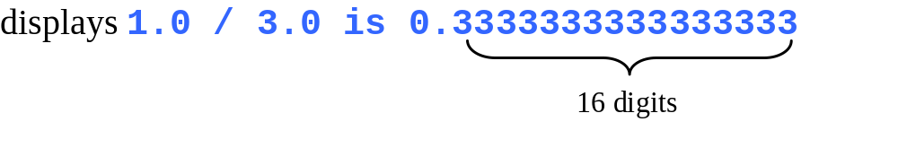
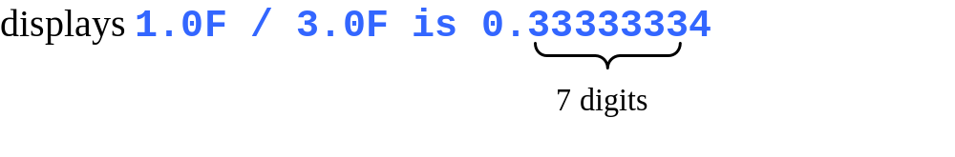
double vs. float
The double type values are more accurate than the float type values. For example,
System.out.println("1.0 / 3.0 is " + 1.0 / 3.0);
System.out.println("1.0F / 3.0F is " + 1.0F / 3.0F);

Slide 8
Scientific Notation
Floating-point literals can also be specified in scientific notation, for example, 1.23456e+2, same as 1.23456e2, is equivalent to 123.456, and 1.23456e-2 is equivalent to 0.0123456. E (or e) represents an exponent and it can be either in lowercase or uppercase.

Slide 9

Arithmetic Expressions
is translated to
(3+4*x)/5 – 10*(y-5)*(a+b+c)/x + 9*(4/x + (9+x)/y)

Slide 10

How to Evaluate an Expression
Though Java has its own way to evaluate an expression behind the scene, the result of a Java expression and its corresponding arithmetic expression are the same. Therefore, you can safely apply the arithmetic rule for evaluating a Java expression.

Slide 11

Problem: Converting Temperatures
Write a program that converts a Fahrenheit degree to Celsius using the formula:
Note: you have to write
celsius = (5.0 / 9) * (fahrenheit – 32)
FahrenheitToCelsius
Run

Slide 12

Problem: Displaying Current Time
Write a program that displays current time in GMT in the format hour:minute:second such as 1:45:19.
The currentTimeMillis method in the System class returns the current time in milliseconds since the midnight, January 1, 1970 GMT. (1970 was the year when the Unix operating system was formally introduced.) You can use this method to obtain the current time, and then compute the current second, minute, and hour as follows.
ShowCurrentTime
Run

Slide 13
ShowCurrentTime.java
Listing 2.7 on page 55

Slide 14
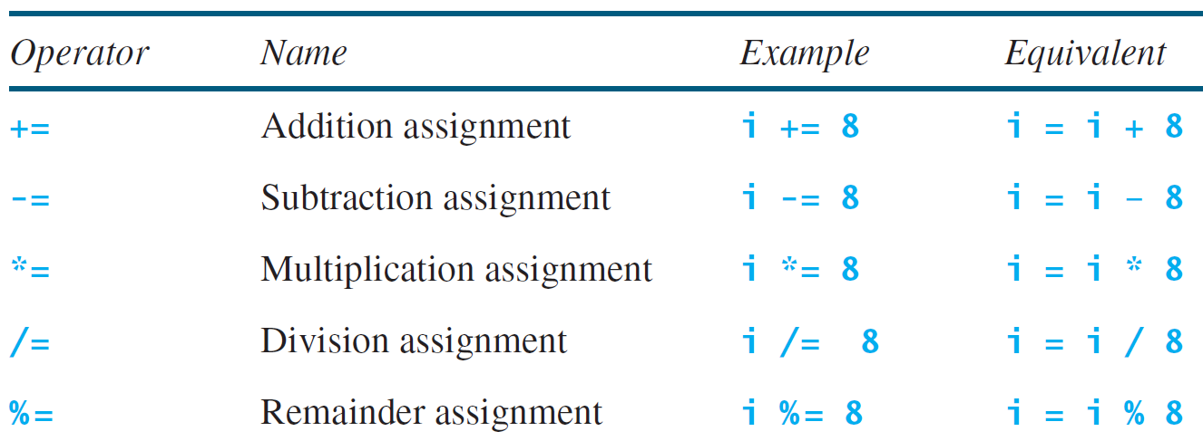
Augmented Assignment Operators

Slide 15
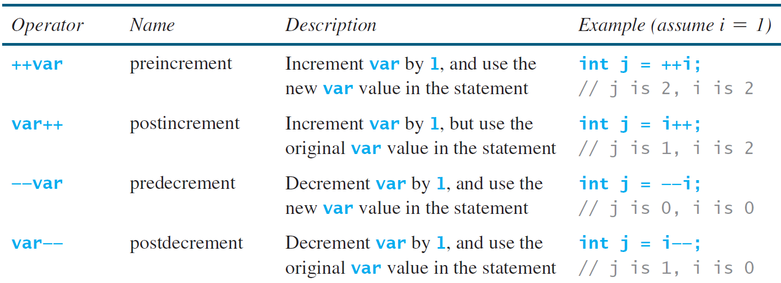
Increment and
Decrement Operators

Slide 16


Increment and
Decrement Operators, cont.

Slide 17
Numeric Type Conversion
Consider the following statements:
byte i = 100;
long k = i * 3 + 4;
double d = i * 3.1 + k / 2;

Slide 18
Conversion Rules
When performing a binary operation involving two operands of different types, Java automatically converts the operand based on the following rules:
1. If one of the operands is double, the other is converted into double.
2. Otherwise, if one of the operands is float, the other is converted into float.
3. Otherwise, if one of the operands is long, the other is converted into long.
4. Otherwise, both operands are converted into int.

Slide 19
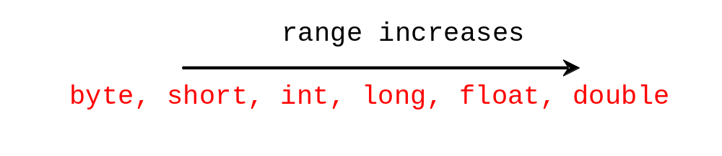
Type Casting
Implicit casting
double d = 3; (type widening)
Explicit casting
int i = (int)3.0; (type narrowing)
int i = (int)3.9; (Fraction part is truncated)
What is wrong? int x = 5 / 2.0;

Slide 20
Problem: Keeping Two Digits After Decimal Points
Write a program that displays the sales tax with two digits after the decimal point.
SalesTax
Run

Slide 21
Problem: Keeping Two Digits After Decimal Points
Write a program that displays the sales tax with two digits after the decimal point.
SalesTax
Run

Slide 22
SalesTax.java
Listing 2.8 on page 60

Slide 23

Problem:
Computing Loan Payments
This program lets the user enter the interest rate, number of years, and loan amount, and computes monthly payment and total payment.
ComputeLoan
Run

Slide 24
ComputeLoan.java
Listing 2.9 on pages 63-4

Slide 25
BMI constants
final double KILOGRAMS_PER_POUND = 0.45359237;
final double METERS_PER_INCH = 0.0254;

